Slide 1
Variables, Operators, and Assignment
Module 2

Slide 2

Variables
Variables store data for clarity or later use
Can be created in a few ways
let – Creates a standard variable that can be reassigned at will
Const – Creates a constant that cannot be reassigned
Used for values that should not change during a program

Slide 3
Variables
Var – Creates a standard variable
This method comes from an older version of JS that should not be used
Although this method is obsolete (we’ll discuss why later), you will see it often in old code

Slide 4

Variables
You can declare multiple variables on the same line
You can declare a variable without any value at all as long as it is not a constant (which cannot be reassigned)

Slide 5
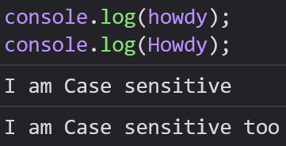

Naming Conventions and Rules
All variables, functions, methods, and Classes must have unique names
Names can begin with an underscore (_), but this practice is reserved for private variables (More on this later)
You may not use keywords as variable names

Slide 6
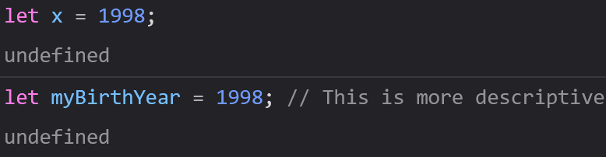
Naming Conventions and Rules
Make your names as descriptive and concise as possible to describe the data in them
Names may never start with a number, but may contain numbers in the
Names are Case sensitive

Slide 7
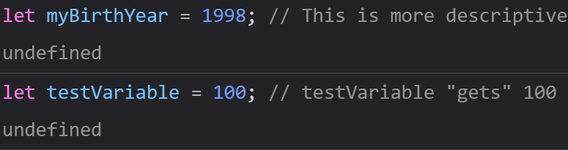
Assignment
Assignment expressions always read from left to right
Variables are assigned using an equals (=)

Slide 8
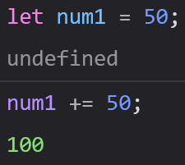
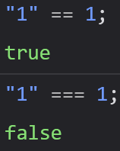
Assignment
Variables work similar to Algebra, but assignment does not
Variables can add to themselves
In JavaScript, = is different from ==, which is different from ===

Slide 9
Operators
Most operators work the way they do in Math, but JS has some exceptions
=: Used for assignment
%: Used for Remainder division (called a Modulus)

Slide 10
Operators
**: Used for exponents
++: Used to Increment (Increase by One)
--: Used to Decrement (Decrease by One)

Slide 11
Assignment Operators
You can do math on a variable and assign it to that variable in the same step
+=: x += 5 is the same as x = x + 5
-=: x -= 10 is the same as x = x – 10
*=: x *= 15 is the same as x = x * 15

Slide 12
Assignment Operators
/=: x /= 20 is the same as x = x / 20
%=: x %= 25 is the same as x = x % 20
**=: x **= 30 is the same as x = x ** 30

Slide 13
Boolean Logic
In programming, all comparisons evaluate to either True or False
This is the basis for most of programming and computer science
You will frequently want to compare two statements to each other

Slide 14
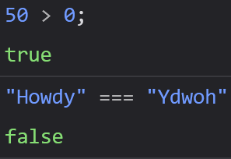


Boolean Logic
Ex: 10 === 10 evaluates as True
Ex: 10 === 0 evaluates as False
Ex: 50 > 0 -> True, “Howdy” === “YdwoH” -> False

Slide 15

Comparison Operators
==: Equal to
===: Equal value and Equal type
!=: Not equal to

Slide 16
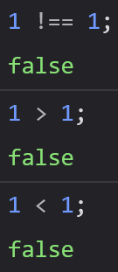
Comparison Operators
!==: Not equal value or not equal type
>: Greater than
<: Less than

Slide 17
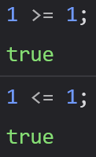
Comparison Operators
>=: Greater or equal to
<=: Less than or equal to

Slide 18


JavaScript’s Equals Operators
=
Assigns a value to a variable
== or ===
Compares one value or expression to another value or expression

Slide 19


JS Comparison Operators
==
Equal to
Allows “Truthy” and “Falsey” statements
“2” == 2 evaluates to True
===
Equal Value and Equal Type
Standard comparison
“2” === 2 evaluates to False (as you would expect)

Slide 20


Logical Operators - &&
&& = AND
Used to check if BOTH statements evaluates to true or false

Slide 21


Logical Operators - ||
||
OR
Used to check if EITHER statement evaluates to true or false

Slide 22

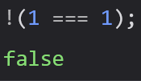
Logical Operators - !
!
NOT
Used to check if a statement is not True or not False

Slide 23
Bitwise Operators
Used when comparing 32 bit numbers
These are by far the most niche operators, as binary is quite rare to come across, particularly in high level programming like JavaScript
Bitwise Operators sometimes come up in machine code or in C|C++, which directly manage the Random Access Memory (RAM) of your computer

Slide 24
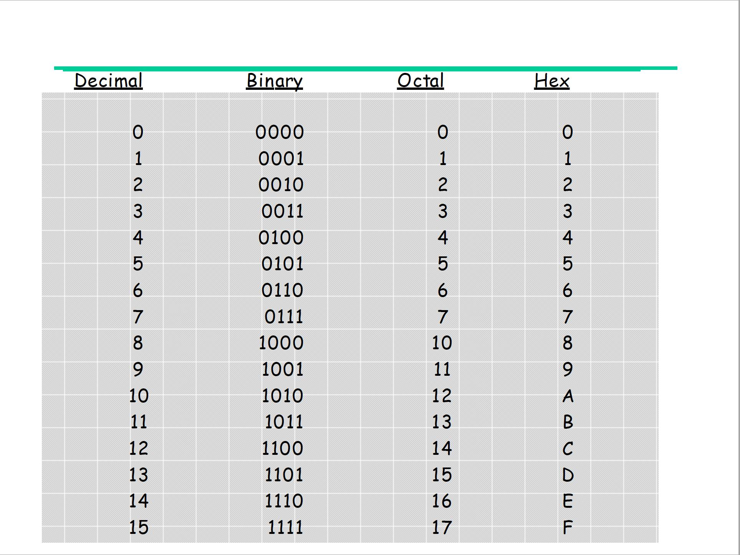
Binary Numbers

Slide 25

Bitwise Operators
&
Bitwise AND
Returns a new number where each bit is set to 1 if BOTH bits are in the same position are a 1
5 in binary is 0101
1 in binary is 0001
5 & 1 => 0101 & 0001 => Only the last bit has both numbers as a 1 => 0001, which equals 1

Slide 26

Bitwise Operators
|
OR
Returns a new number where each bit is set to 1 if either bit in the same position is 1.
5 | 1 => 0101 OR 0001 => 0101, which equals 5

Slide 27

Bitwise Operators
^
XOR (Exclusive OR)
Returns a new number where each bit is set to 1 only if the bits in each position are different
5 ^ 3 => 0101 XOR 0011 => The second and third bits are opposites => 0110 => 6

Slide 28

Bitwise Operators
~
NOT
Only bitwise operator that operates on a single number (~5)
Returns a new number where each bit is the opposite of the original binary number
~5 => NOT 0101 => 1010 => 10

Slide 29

Bitwise Operators
<<
Left Shift
Shifts each bit of a number to the left by a specified number of positions
5 << 1 => Shifts the bits of 5 by 1 position => 0101 => 1010 => 10

Slide 30

Bitwise Operators
>>
Right Shift
Shifts each bit to the right by a specified number of positions.
Fills the left side with 0s if positive, 1s if negative.
Discards bits shifted off the right side
5 >> 1 => Shifts the bits of 5 to the right by 1 position => 0101 => 0010 => 2

Slide 31

Bitwise Operators
>>>
Unsigned Right Shift
Shifts bits to the right a specified number of positions.
Will always fill the left side with 0s regardless of whether the number was positive or negative

